Slide 1

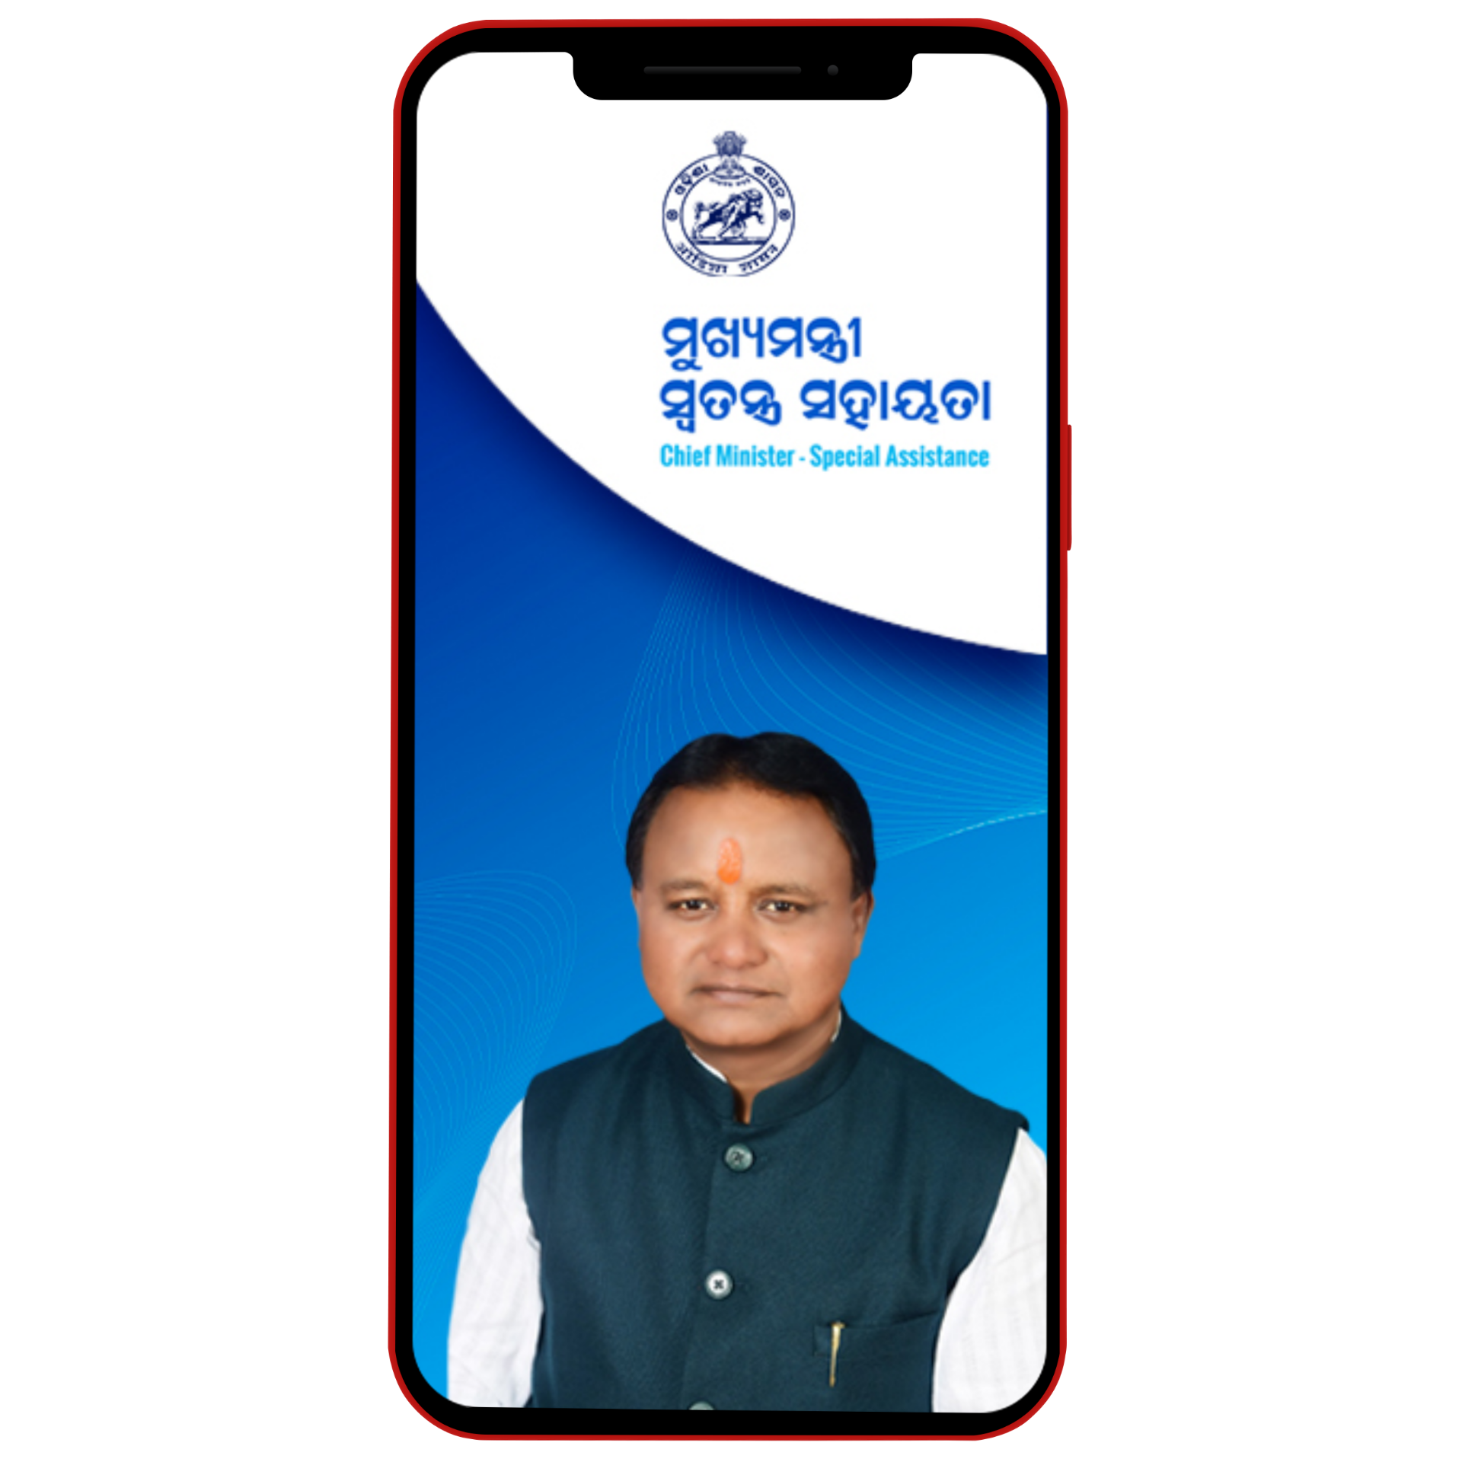



MOBILE APP

Slide 2

CONTENT LIST
PRESENTATION
01.
02.
03.
04.
05.
APPLICATION SHOWCASE
INTRODUCING APP
PURPOSE OF MAKING THIS APP
HOW TO USE APP MOBILE VERSION
CONCLUSION OF THIS PROJECT APP

Slide 3

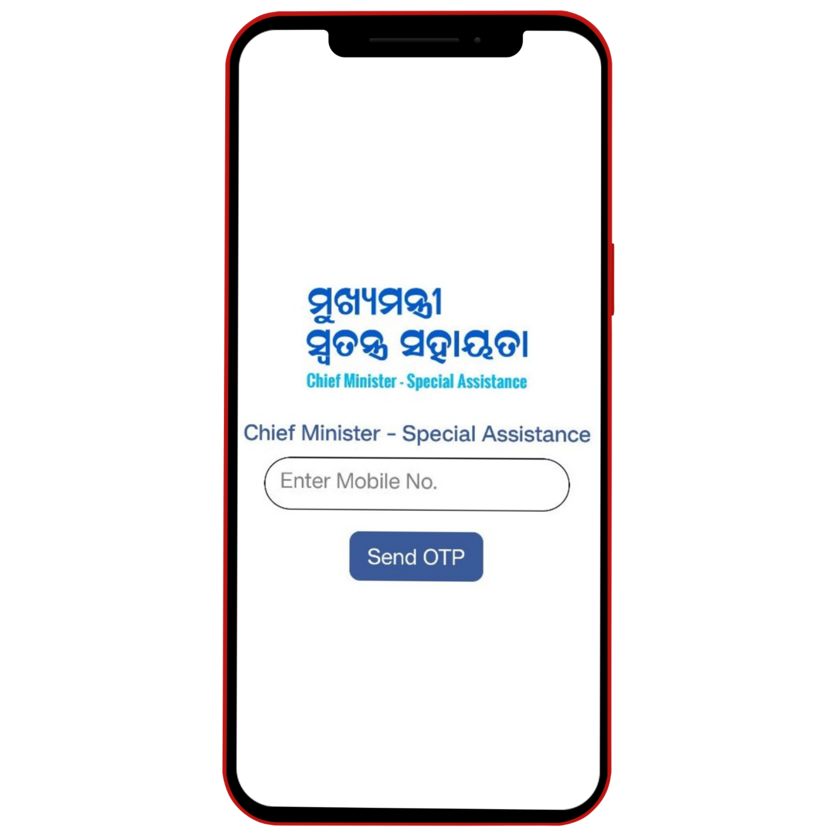
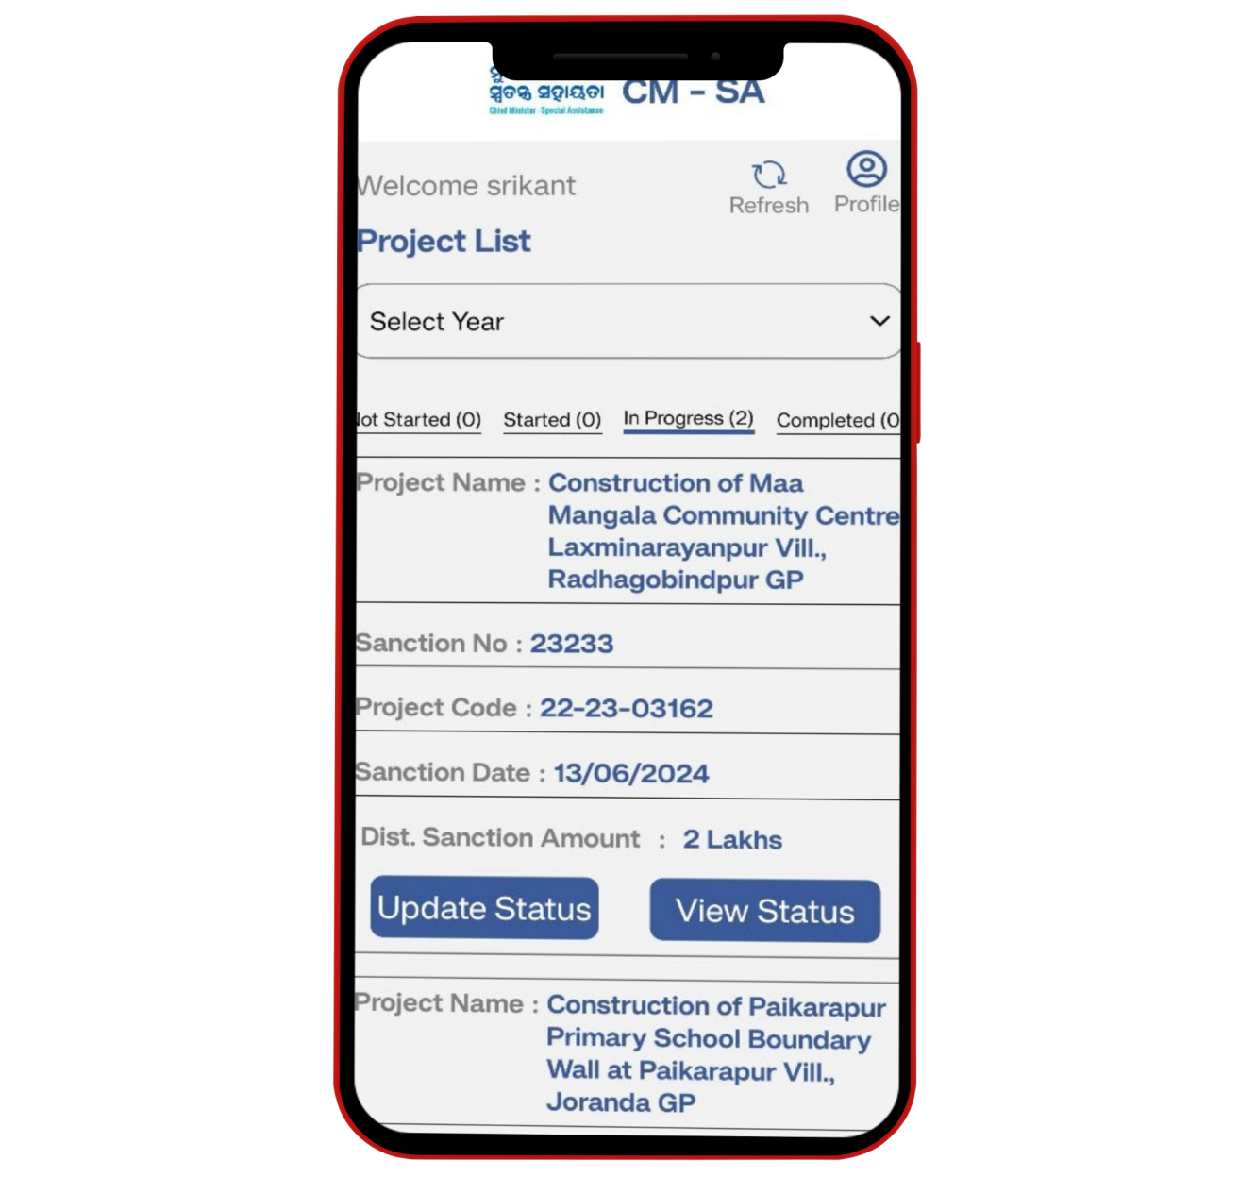
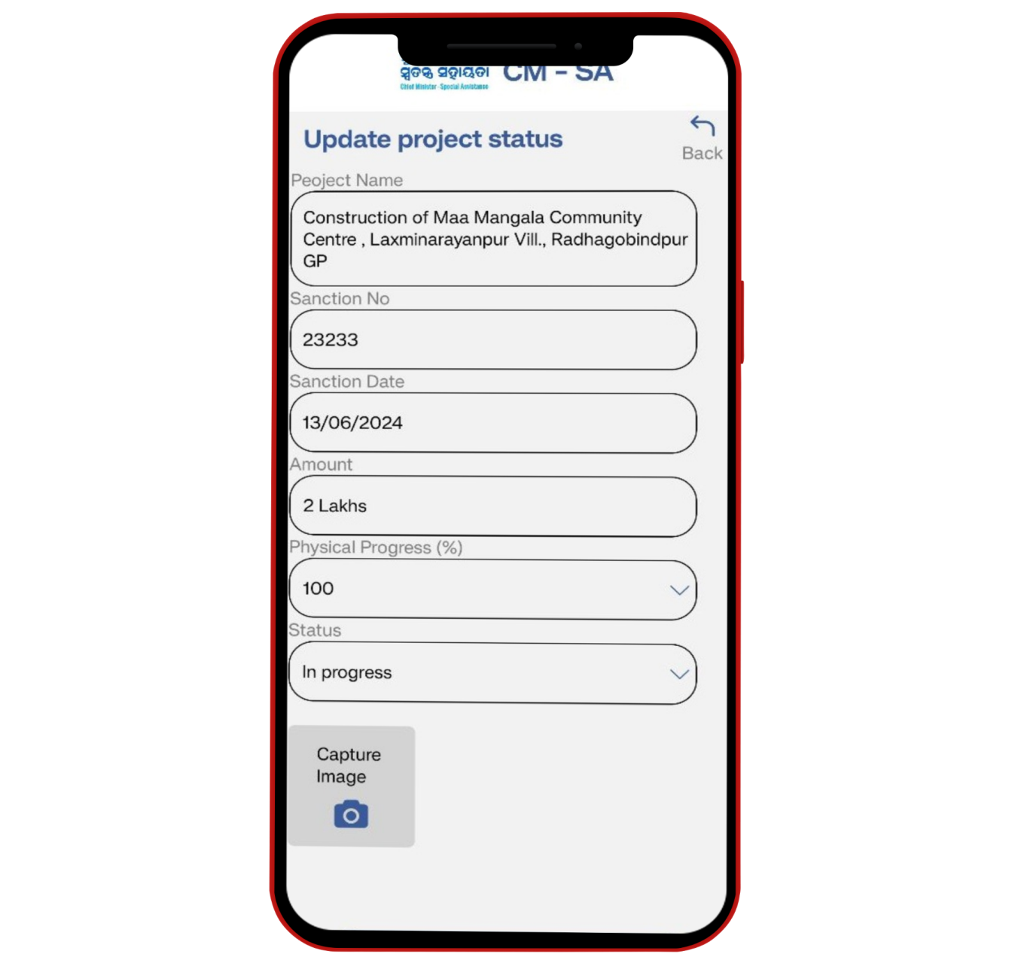
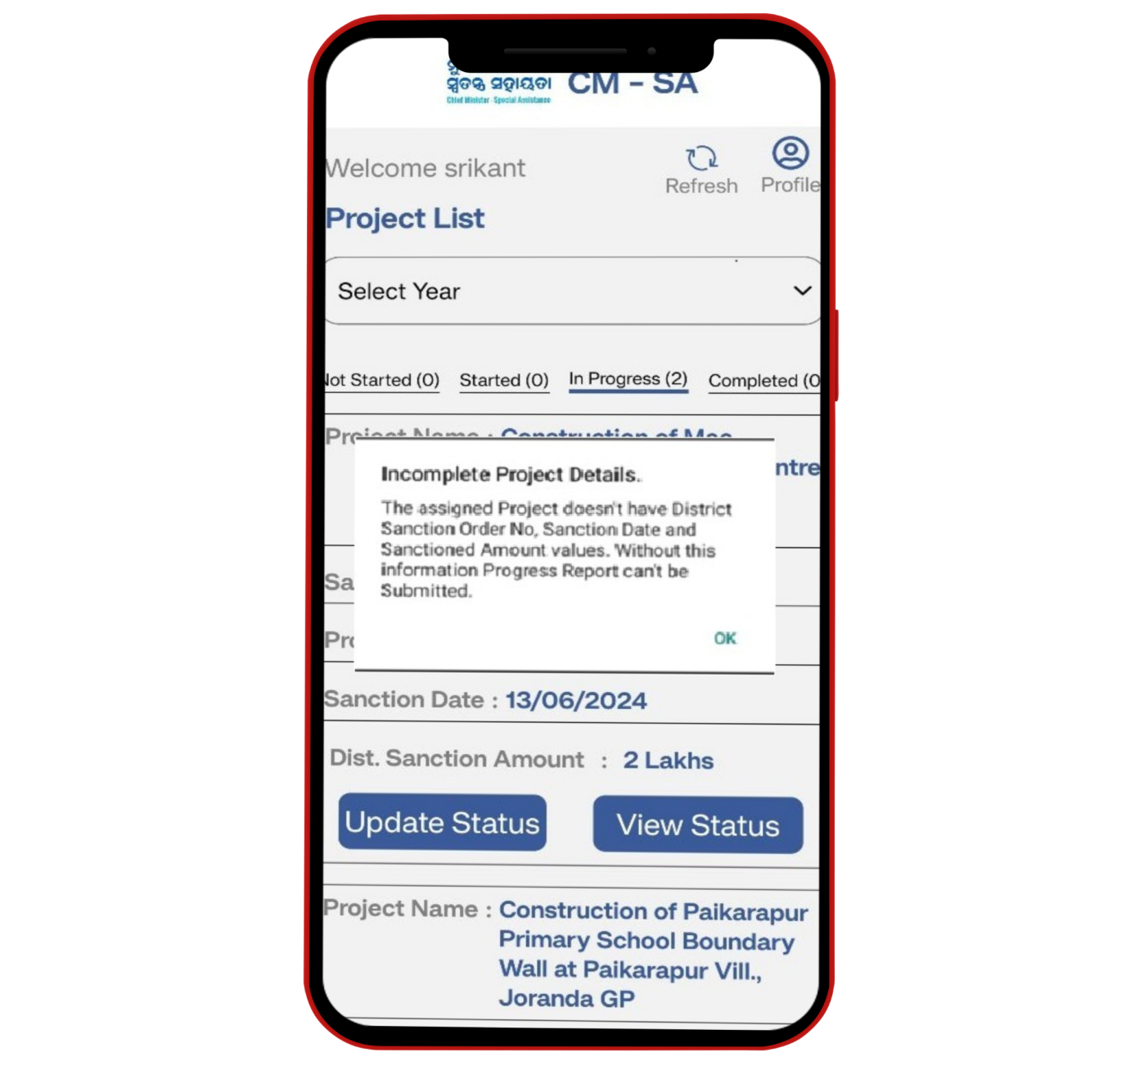
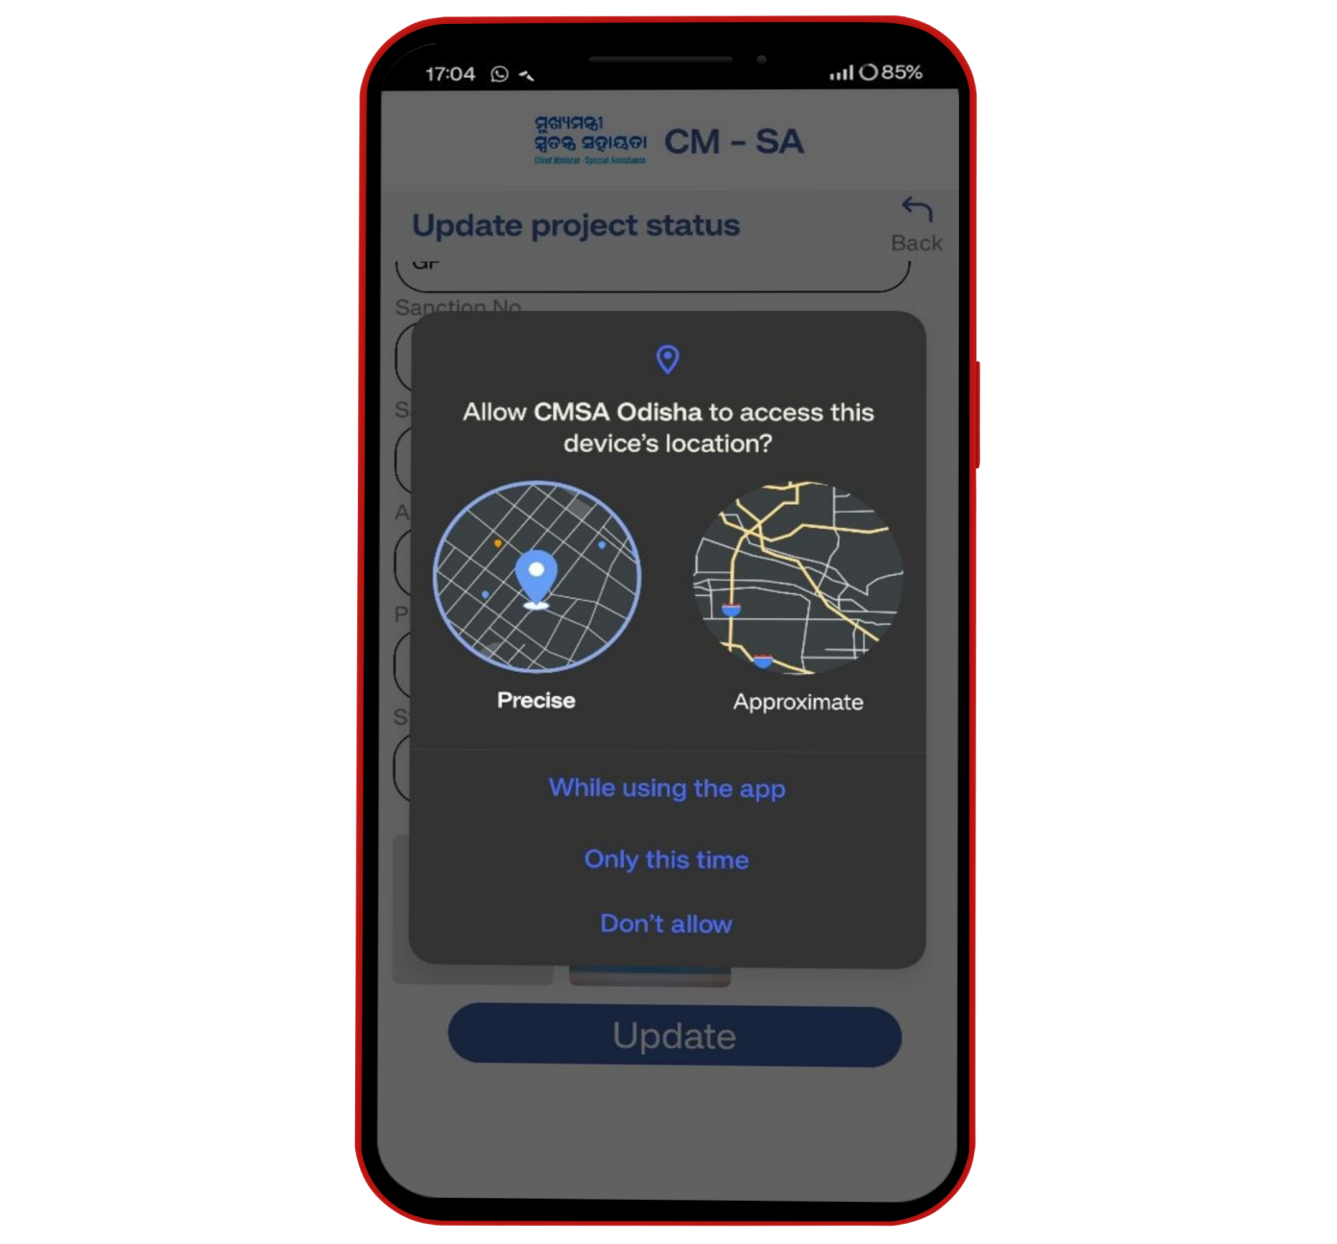
APPLICATION SHOWCASE
CMSA MOBILE APP.
This Mobile app is specifically designed for Executing Agency Representatives (EAR)
for project site inspection with geo-tagged photo capturing option.

Slide 4

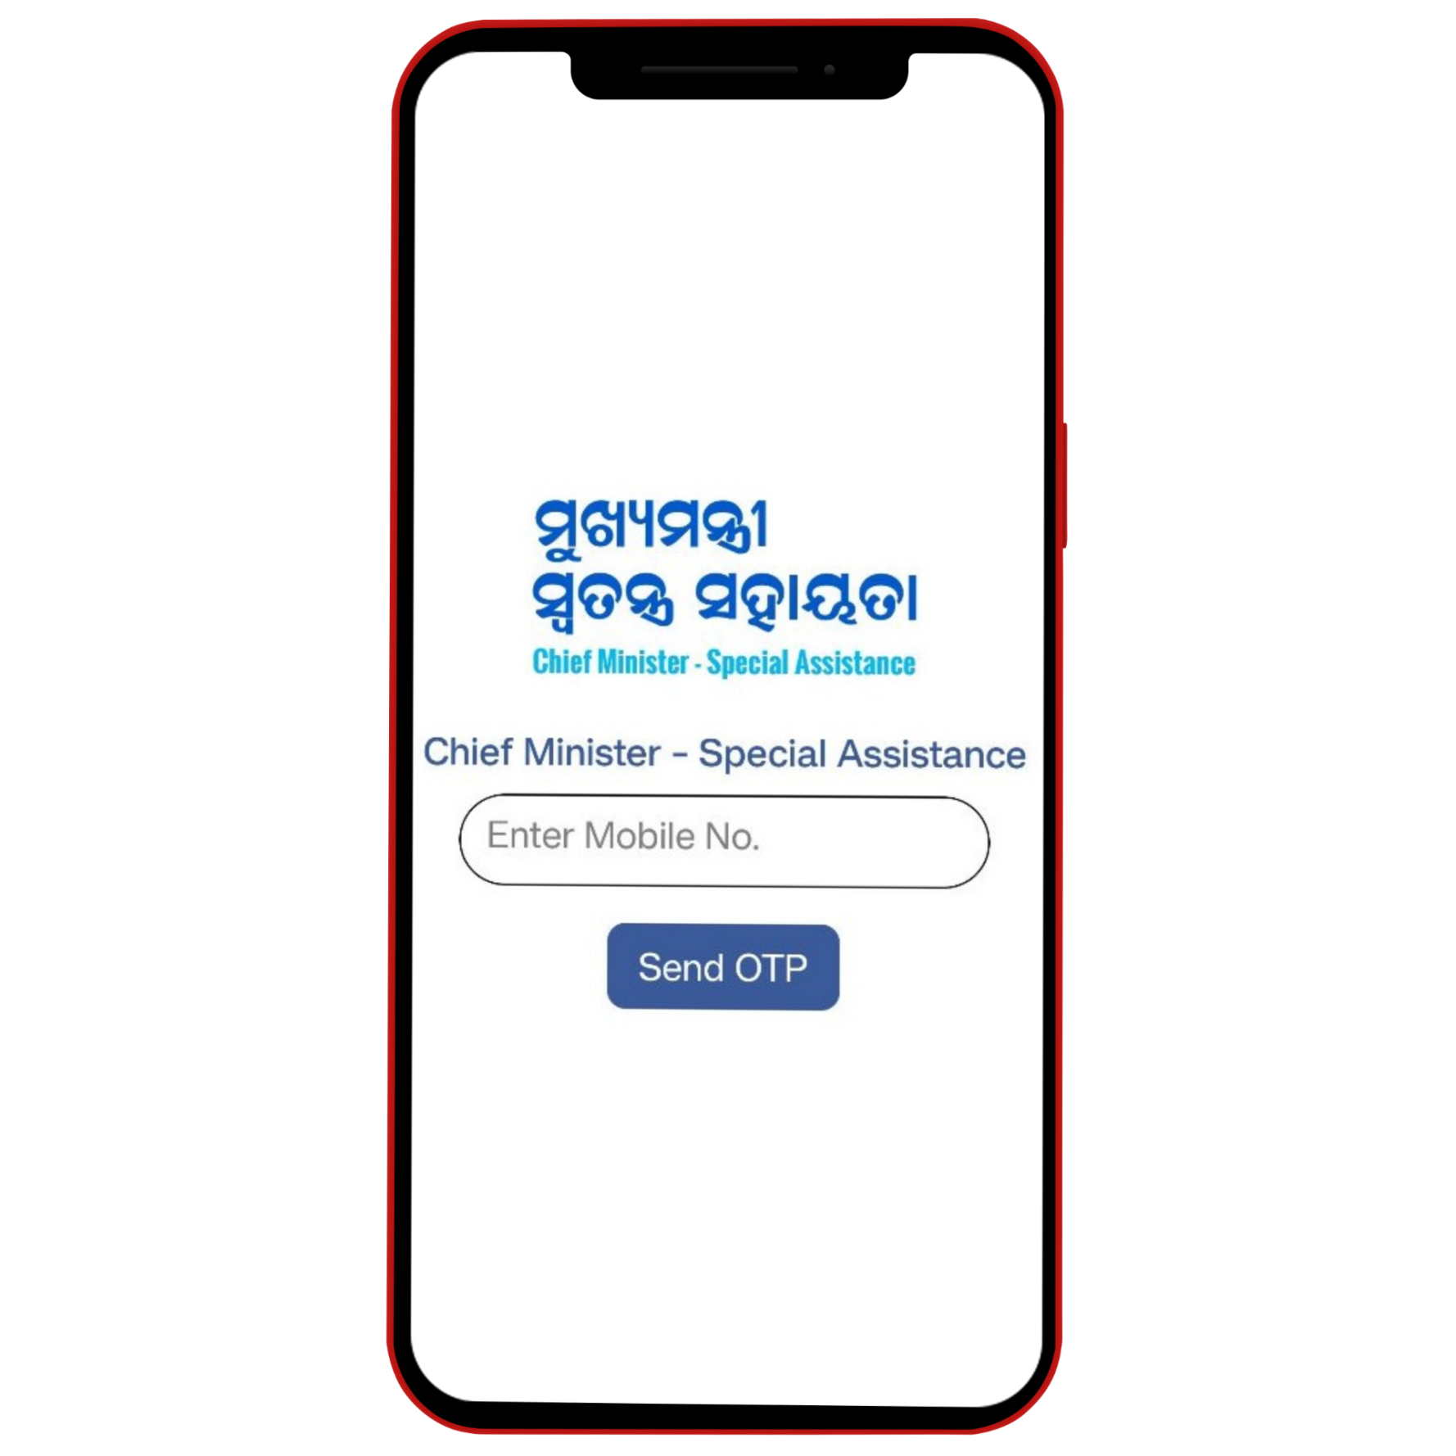
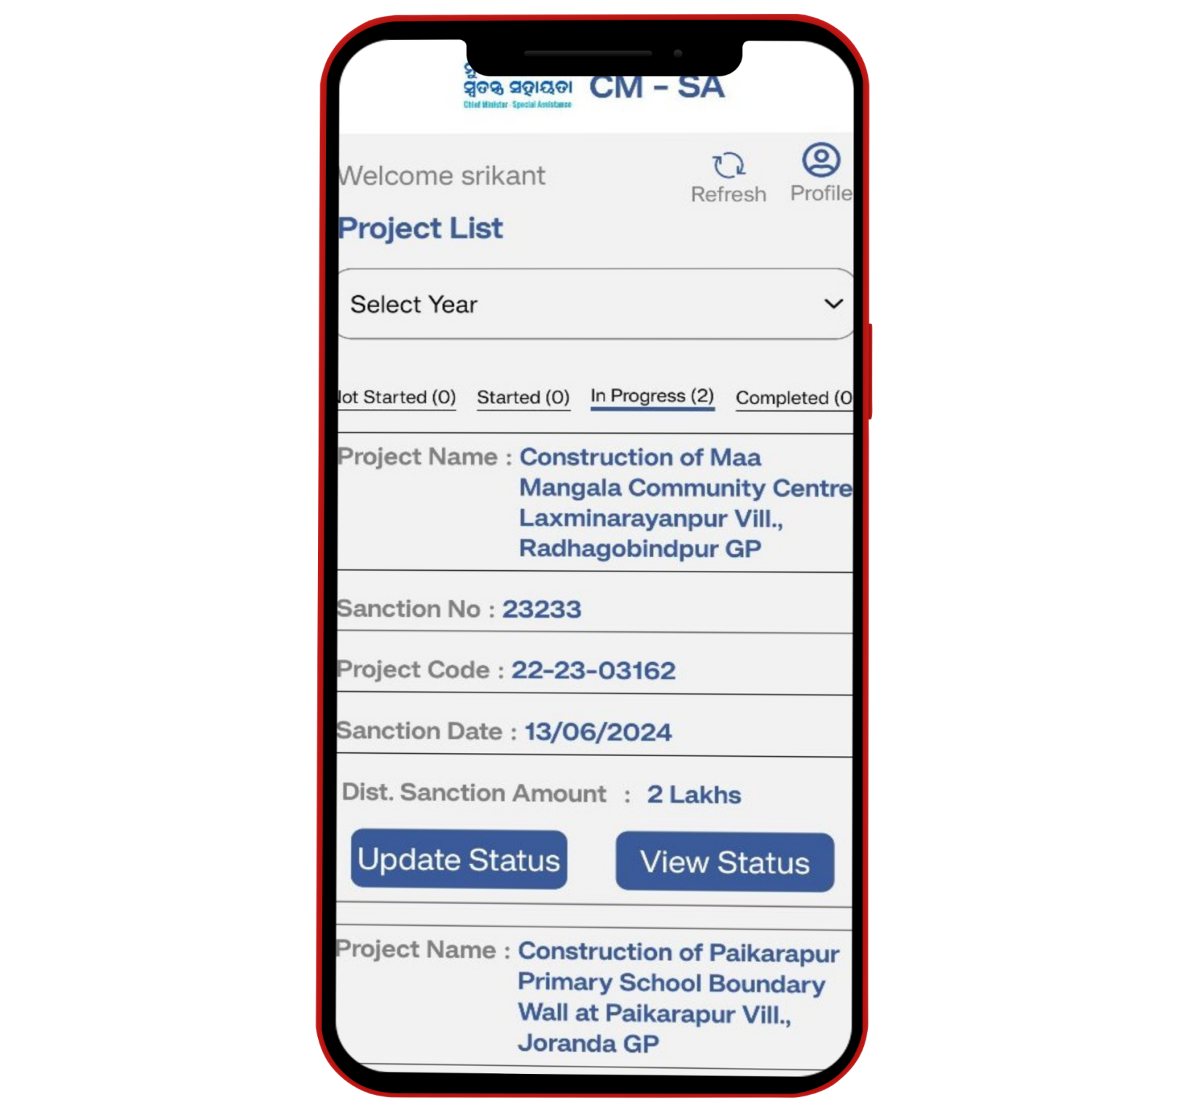


INTRODUCING
APP
EASY TO USE
WORK EASIER EXECUTING AGENCIES & EA REPRESENTATIVE
WORK ANYTIME, ANYWHERE
ACCESS THE LOCATION

Slide 5





PURPOSE OF
MAKING THIS APP
WORK EFFECTIVENESS
ORGANIZED WORK
MONITORED WORK

Slide 6
QUICK OVERVIEW
OF THE PROJECT ASSIGNMENT TO EA REPRESENTATIVE AND PROGRESS REPORT SUBMISSION
• Using the CSMA Web Application, the Executing Agency (EA) will assign Not Started, Started, Inprogress, and Completed Projects to the Executing Agency Representative (EAR).
• EAR will find the project details in the mobile app after login.
• Once a project is marked as completed, EAR cannot change the Physical Progress % or project status. In the mobile app, EAR will only upload the photos and submit them for EA review and approval.
• EA login into the CMSA Web application, goes to the Progress Report List, checks the uploaded photos in the View Details screen, deletes any photos as needed, and approves the progress report submitted from Mobile.
• Once the EA approves the Progress Report taken from Mobile with Completed status, the project will not be allowed to have further Progress Report.

Slide 7

HOW TO USE APP
mobile version
  STEP ONE
Click on the CMSA icon, and it will welcome the users.

Slide 8

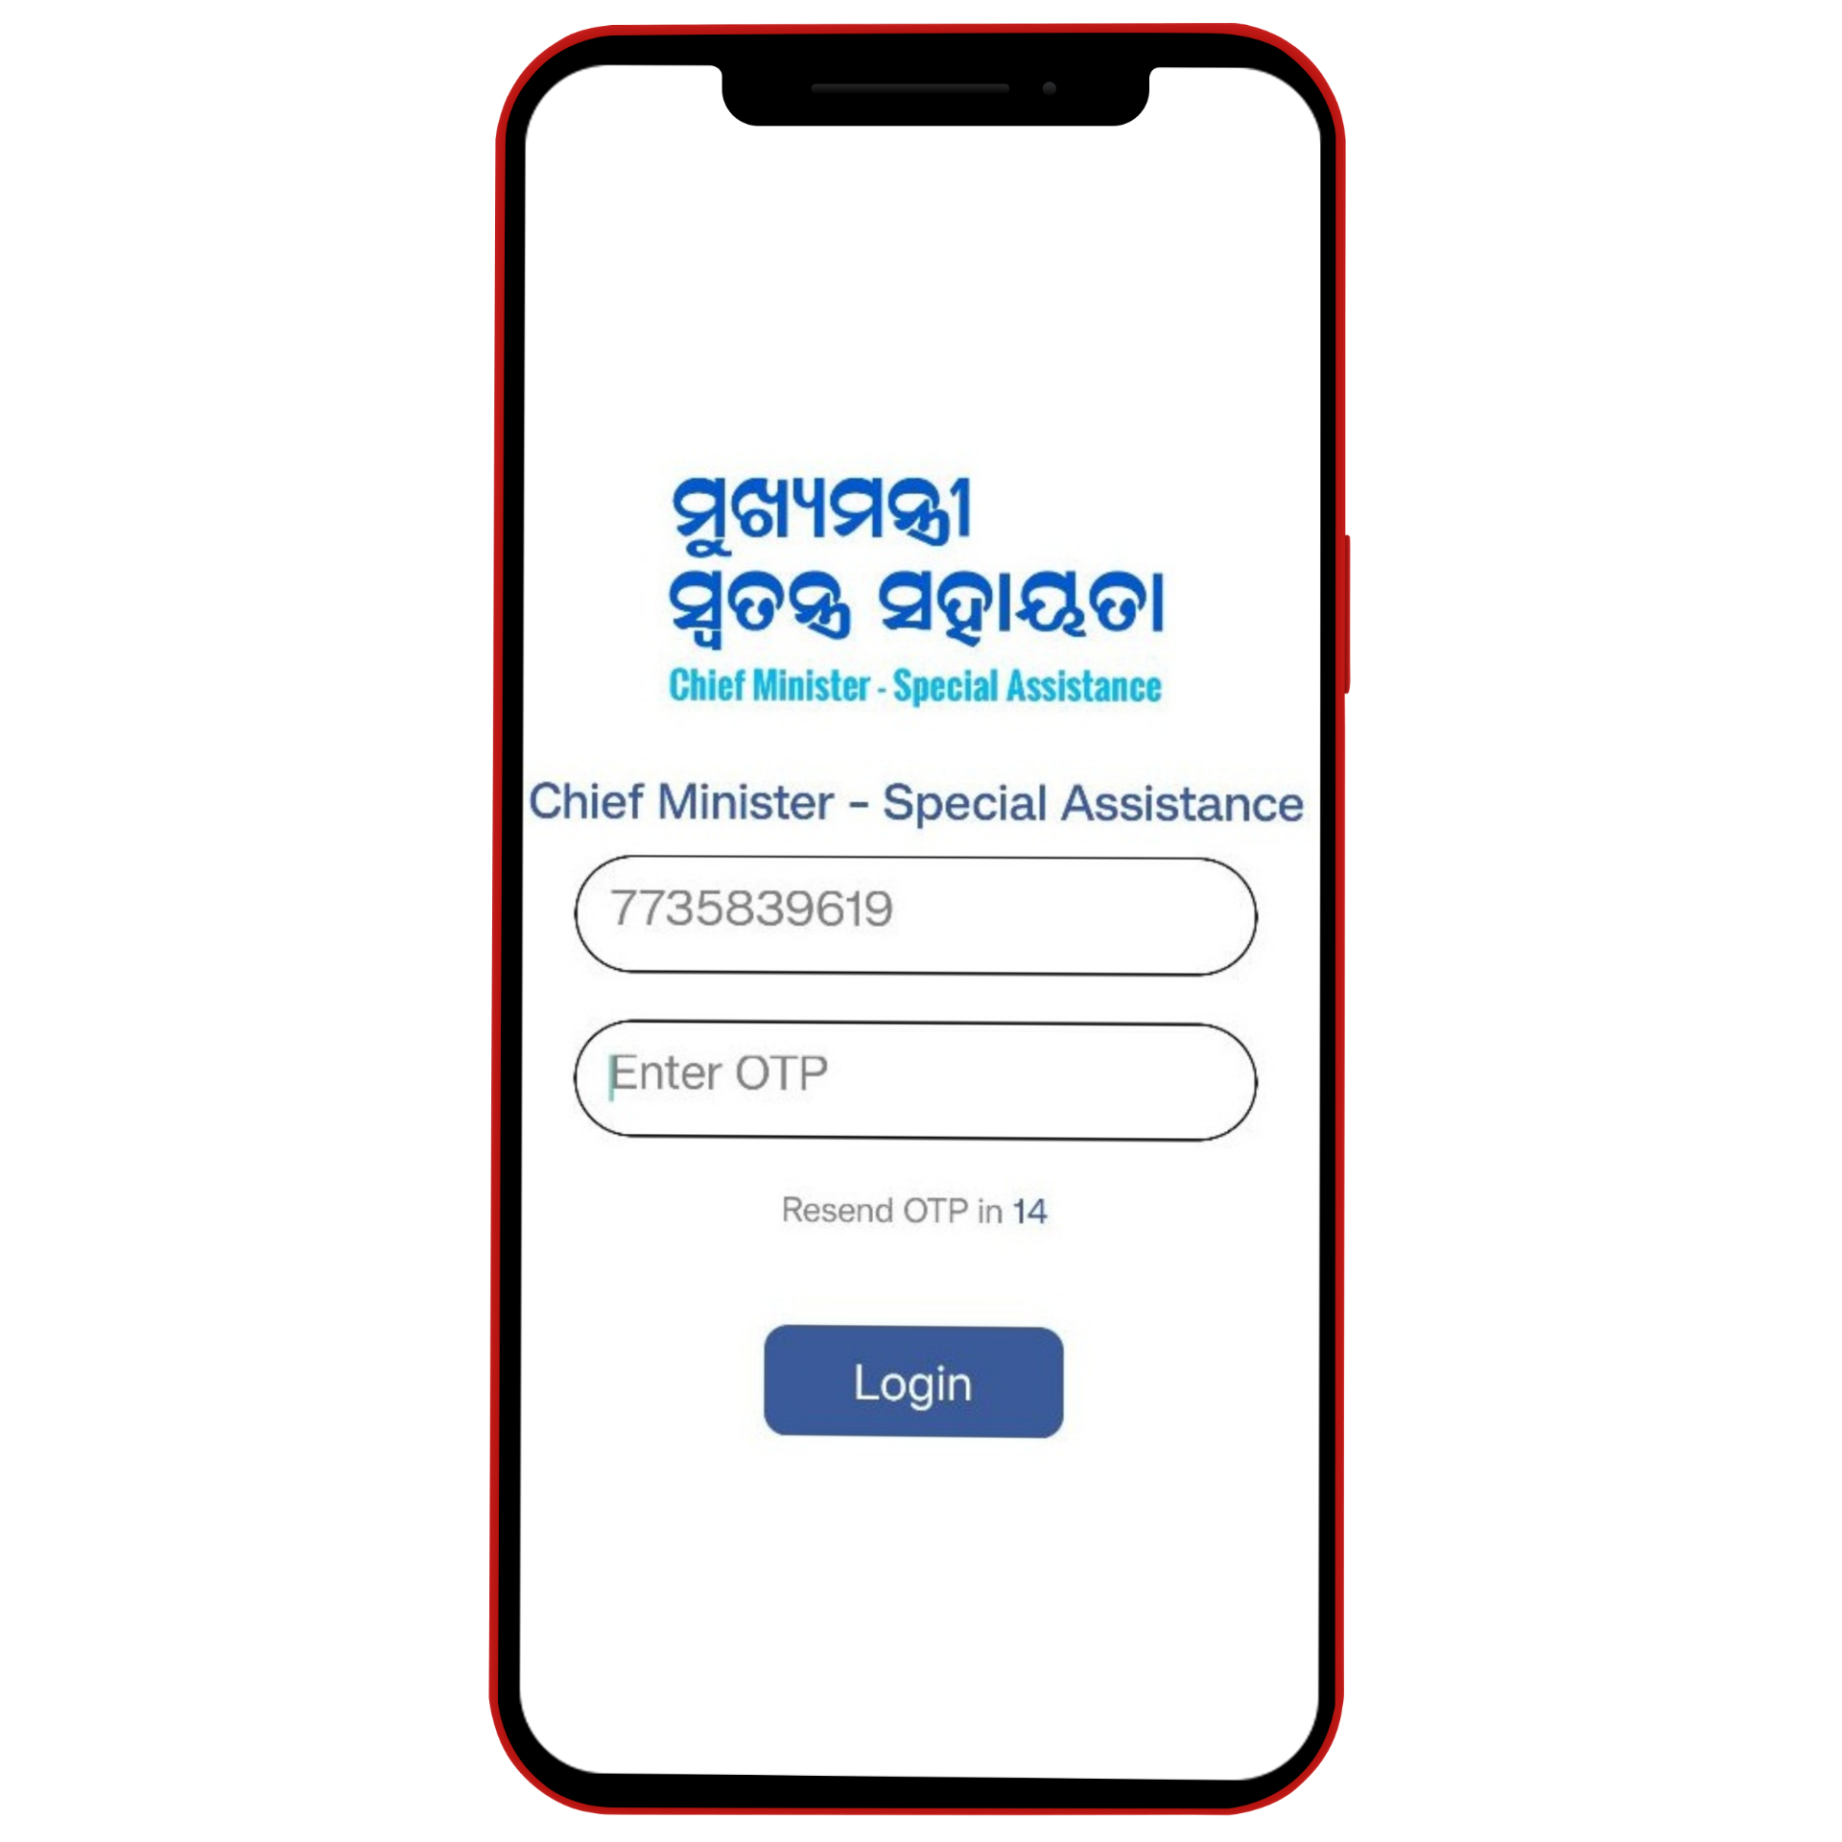
  STEP TWO
Enter your mobile number and OTP to log in.

Slide 9

  STEP THREE
After logging in, it will welcome the Executing Agency Representative and show the project list: Not Started, Started, In Progress, and Completed tabs.
User is able to Refresh the page and log out after completing the inspection work.

Slide 10

  STEP THREE CONTINUED...
Warning message in case the district project details were not updated before the project was assigned to the Executing Agency Representative.

Slide 11
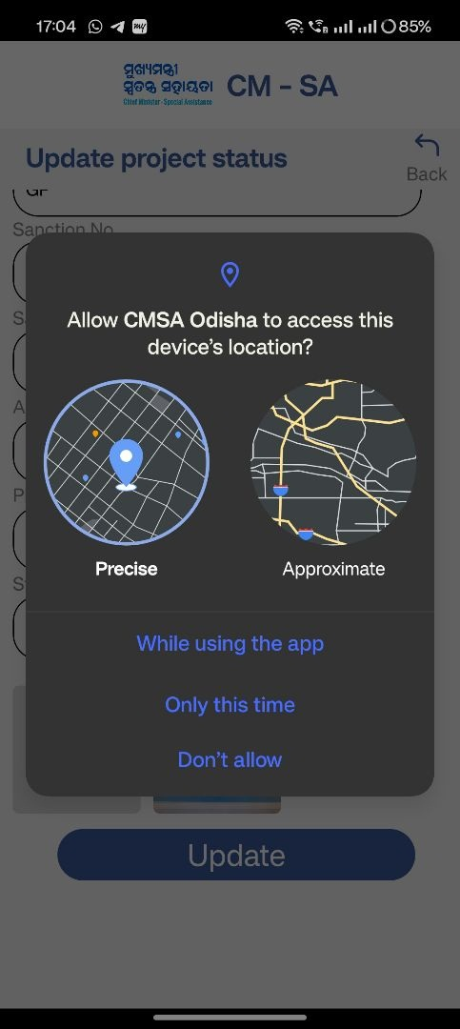
  STEP FOUR
Click on Update Access and allow the device location.

Slide 12
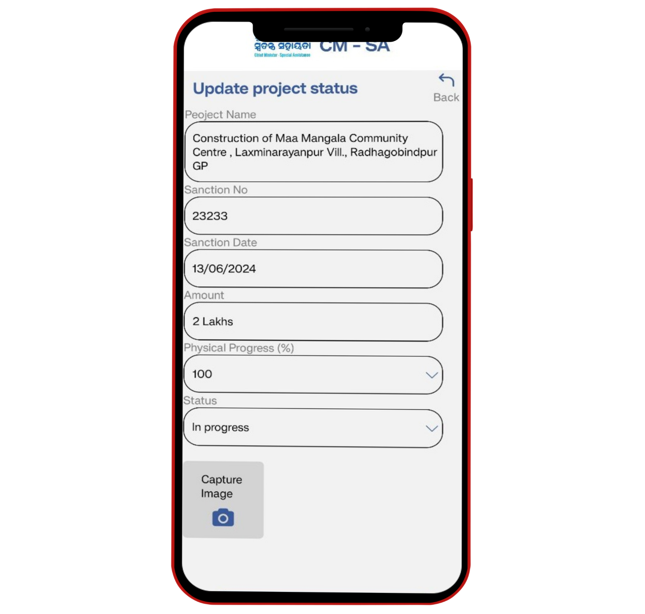
  STEP FIVE
Mention the project status (Not Started, Started, In Progress, Completed) and physical progress (in%).
If the project assigned to EAR in Completed status, then Physical Progress and Status information is not be editable. Only photos can be captured by EAR
Now, capture the image, and click on Update.

Slide 13
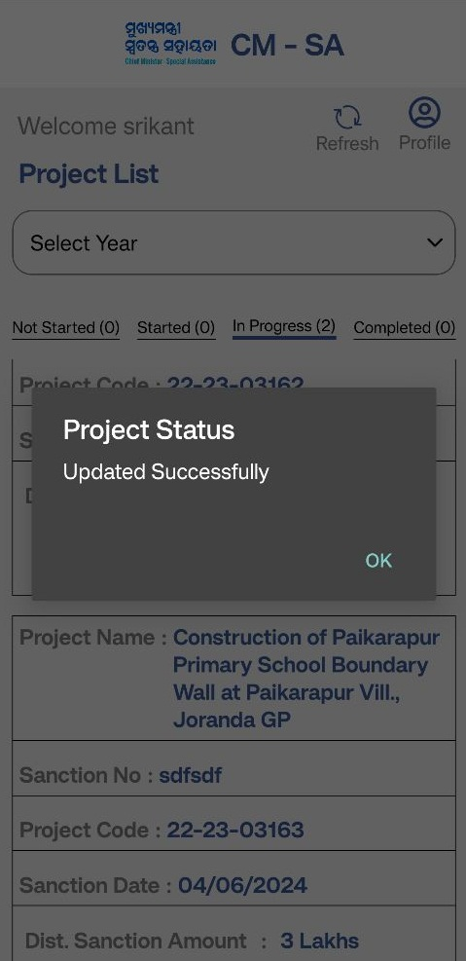
  STEP FIVE CONTINUED...
Executing Agency Representative Update Acknowledgement.

Slide 14
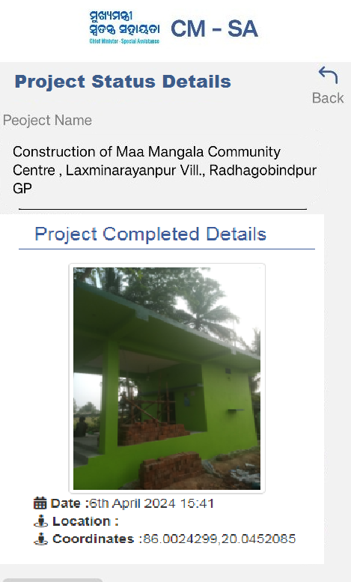
  STEP SIX
View Status Option - After updating the progress status details, the project photos will be visible in the Mobile App .

Slide 15
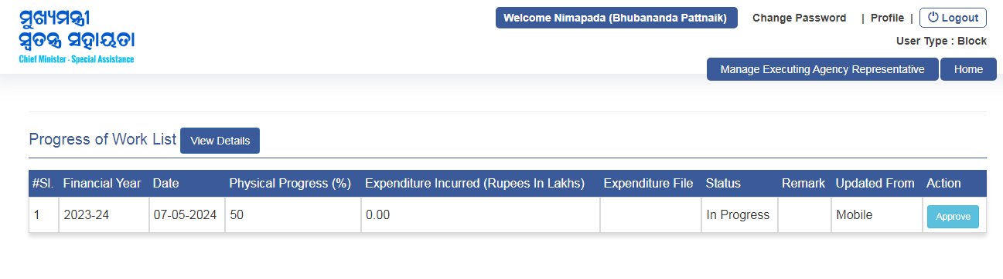
  STEP SEVEN
Executing Agency Login: After the EAR submits the Progress Report using the Mobile App, the attached data appears on the Executing Agency login page by navigating to the "Progress of Work List" page.

Slide 16
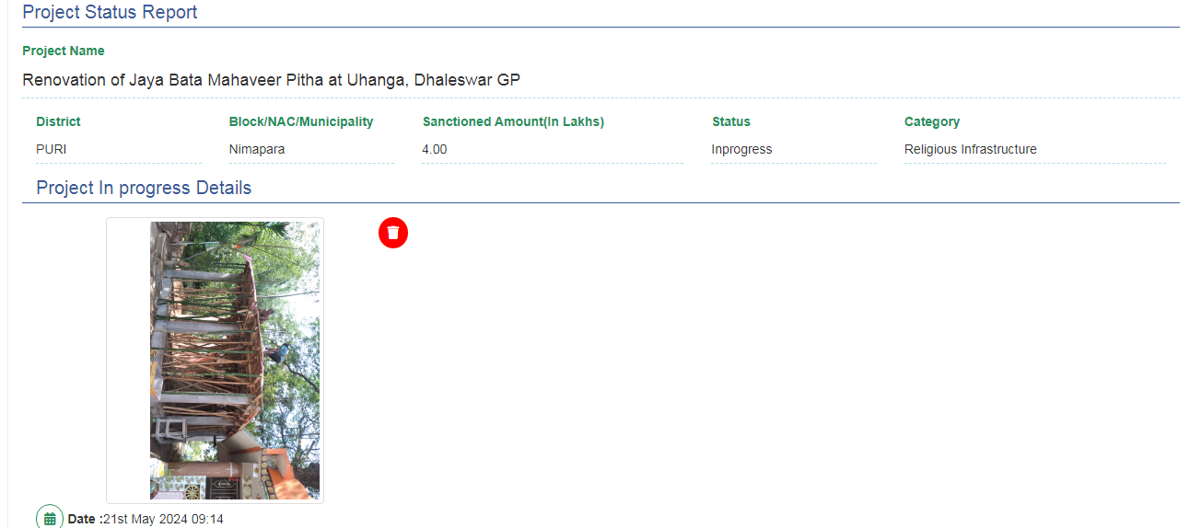
  STEP EIGHT
The Executing Agency approves the Progress report submitted by the EA Representative by updating the Financial Amount spent so far and the Bill Voucher copy upload. Once approved, the details of the photos will be seen on the Project Details page.

Slide 17
CONCLUSION OF
THIS PROJECT APP
  It is useful for the Executing Agency Representatives to access and capture image.
  Geo location facility for accurate position of the place.
  The Executing Agency can monitor and approve the exact information.
  The Progress report data will be viewed by the State and District Users.
  Offline mode of photo capturing and deferred synchronization.

Slide 18

THANKS FOR WATCHING
CMSA MOBILE APP FOR P&C DEPARTMENT, GOVERNMENT OF ODISHA.

Slide 19
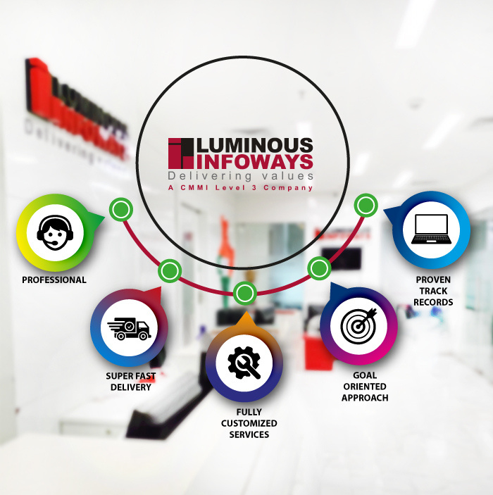




NEED MORE INFO ?
CONTACT US
CONTACT US
info@lipl.in
+916742304010
https://luminousinfoways.com
DCB 615/616/617, 6th Floor, DLF Cyber City, Bhubaneswar-751024, Odisha, India.

